Slide 1
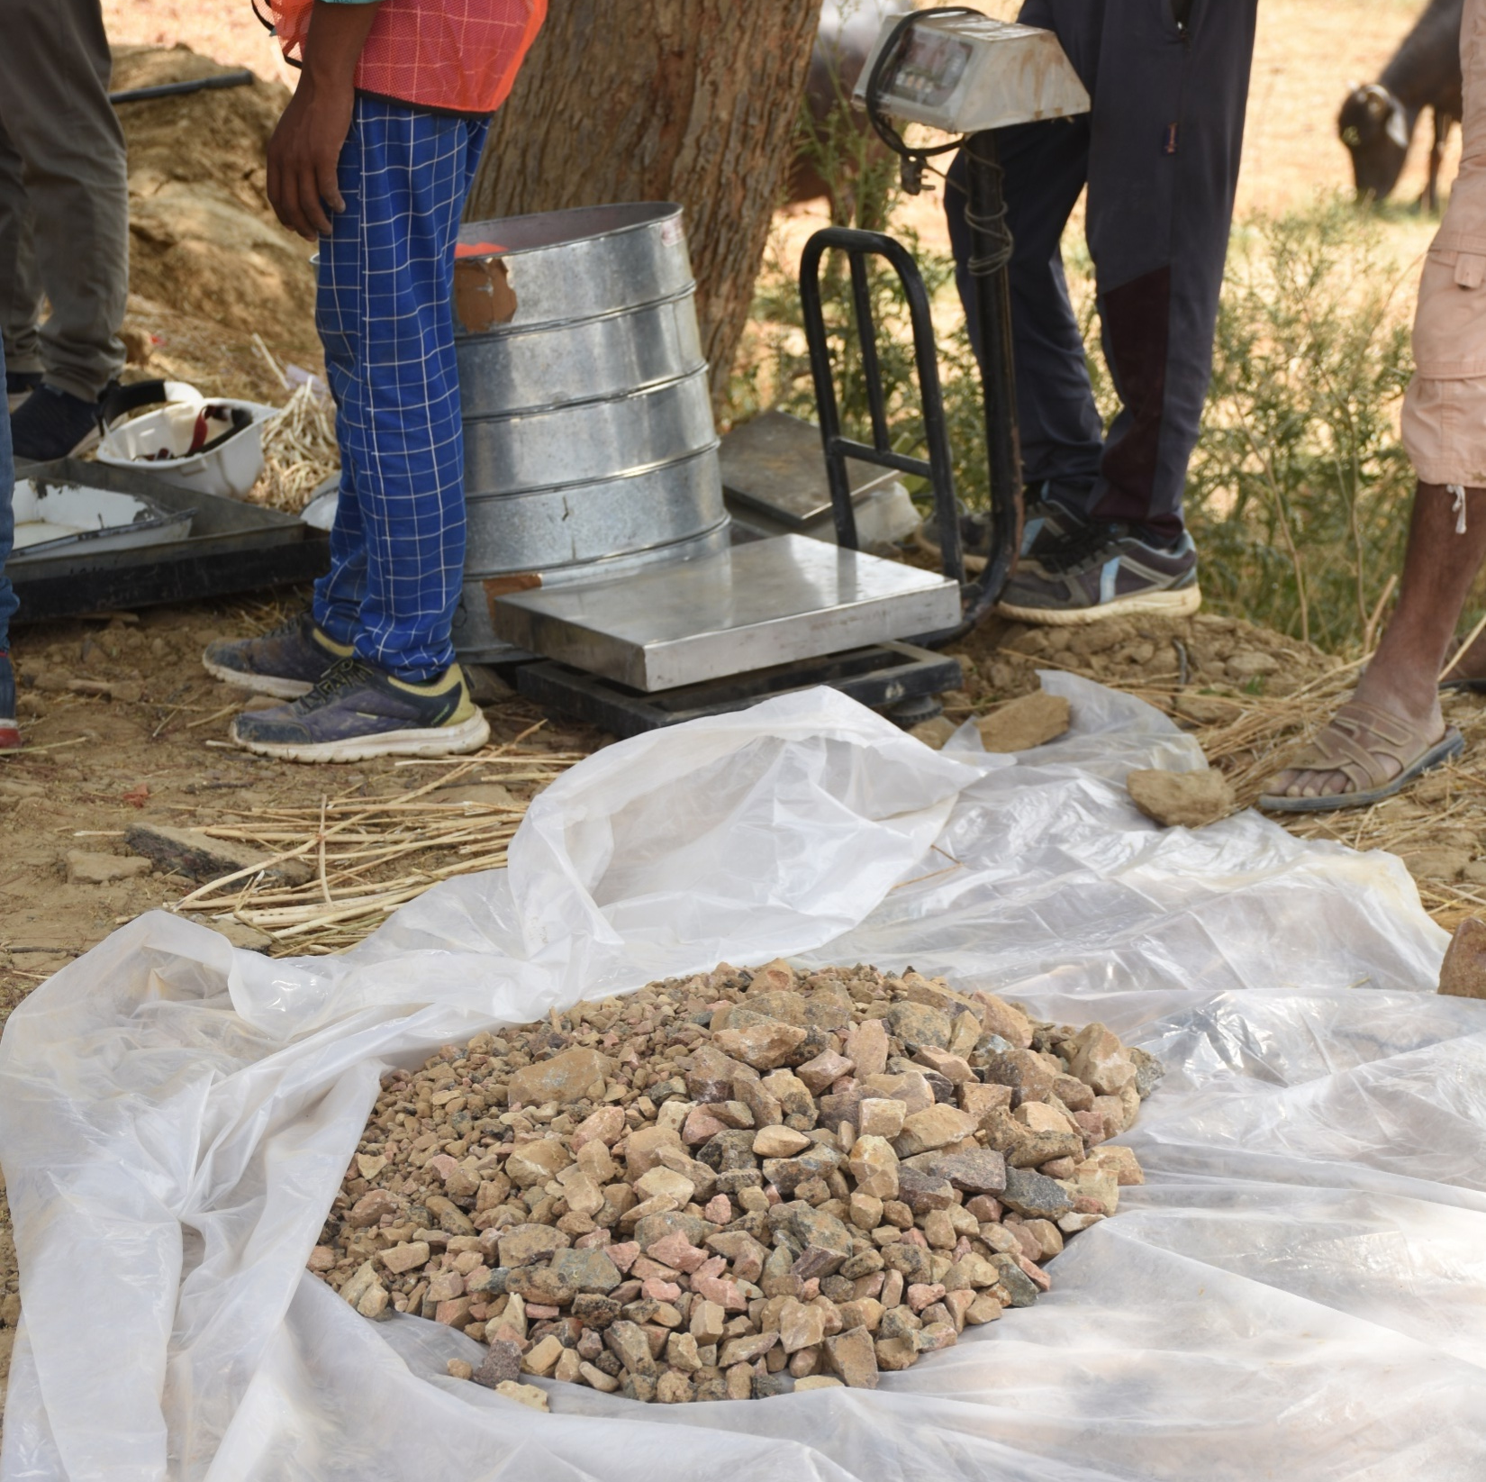
PMGSY
QUALITY CONTROL
MECHANISM
In
Full Depth Reclamation
20 September 2022, Lucknow
Brijesh Dubey
State Quality Coordinator
Uttar Pradesh Rural Roads Development Agency

Slide 2
Introduction
Since inception of PMGSY 7,04,804 Km roads have been constructed in India.
For sustainable development of Infrastructure :
Need to save the limited natural resources
Increase reuse, recycling and reprocessing
Need to use the locally available materials
Use Eco-friendly Construction Technologies
Adoption of New Technologies for developing low cost durable roads
The successful construction of FDR with cement/CCS relies on the control of depth and uniformity of pulverization, strength of compacted subgrade, cement content and placement moisture content of reclaimed mix, and compaction of reclaimed layer. If the sub-base/subgrade material below the FDR layer is soft, it will not adequately support the FDR equipment and/or layer,

Slide 3
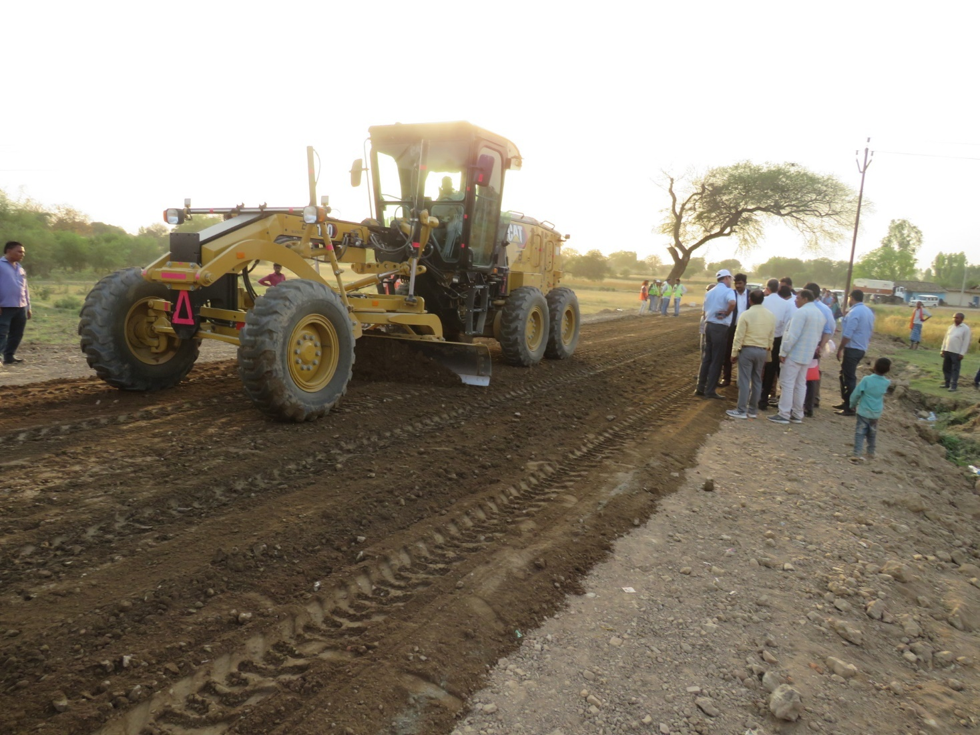
Stabilization Guidelines
IRC:28-1967: “Tentative Specifications for the Construction of Stabilized Soil Roads with Soft Aggregates in areas of Moderate and High Rainfall”
IRC:33-1969: “Standard Procedure for Evaluation and Condition Survey of Stabilized Soil Roads”.
IRC:49-1973: “Recommended Practice for the Pulverisation of Black Cotton and Soils for Lime Stabilization.
IRC:50-1973: “Recommended Design Criterion for the use of Cement Modified Soils in Road Construction”.
IRC:51-1992: “Guidelines for the use of Soil-Lime Mixes in Road Construction”.
IRC:88-1984: “Recommended Practice for Lime-Fly Ash Stabilized Soils Base/Sub-Base in Pavement Construction”.

Slide 4
Full Depth Reclamation (FDR)
FDR is a rehabilitation method that involves recycling of the existing layers of asphalt pavement along with under lying granular (WBM, WMM and GSB) layers.
Stabilizing reclaimed layer with cement and Commercial Chemical Stabilizer (CCS).

Slide 5
Commercial Chemical Stabilizer (CCS)
Natural Inorganic Powder Binders
Water Repelling Nano Chemicals
Waste Oil
Petroleum Based Products
Liquid Stabilized Products
Synthetic Polymers
Sulphonate Lignin etc.

Slide 6
  MoRTH File No. RW/NH-33044/18/2020-S&R (P&B) dated 14.12.2020
1-It is clarified any new alternate, material & technology that has been accredited by IRC, and falling under IRC:SP-89 (Part-II), will not require further accreditation, and will henceforth fall under approved, alternate, material and technologies. For such approved, alternate material and technologies, the Defect Liability Period shall be at par with convention/flexible pavement.
2-“It is clarified that the material/technology for which Codes, Standards, Specifications, Guidelines etc. of IRC, MoRTH, AASHTO, ASTM, Euro Code and British Codes are available shall not be treated as new/alternate material/technology and, as such Defects Liability Period (DLP) of projects using such material/technology shall not fall into the category corresponding to new material/technology. Hence the defect liability period will be at par with conventional/flexible pavement. The stretches where new material/technology is used for which Codes, Standards, Specifications, Guidelines etc. of IRC, MoRTH, AASTHO, ASTM, Euro Code and British Codes, FHWA guidelines are not available, the project may be taken up on pilot basis and the Defects Liability Period of such projects shall be 10 years.”

Slide 7
Commercial Chemical Stabilizer (CCS)
Proven CCS
Non Proven CCS
In case the CCS has been already proven for successful usage in different weathering conditions in India for any category of roads, test reports of such road tracks done should be furnished and shall be alone adequate for its considerations if a separate fatigue equation for such stabilizer is developed through reputed Institute like IIT’s, NIT’s, CRRI etc. the same can be used at the discretion of the user.
Country of origin with successful project report and field evaluation reports.
Certificate of usages in India in last 2 years.
Success rate of the new technology in Indian condition as per last 2 years data.
Quantum of work completed in Government Projects using new technology.
Field Evaluation report by Government institutes/Organizations on roads constructed with new technology.
Reference : File No. RW/NH-33044/18/2020-S&R(P&B) of
Government of India, Ministry of Road Transport & Highways dated 14.12.2020.
Important Aspect for CCS-
CCS materials do not contain toxic/heavy metals which due to leach ability may affect the soil, plants and ground water.

Slide 8
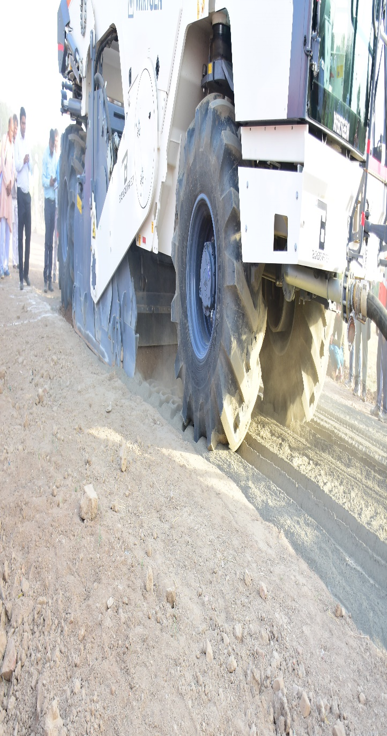
Factors Affecting Stabilization
Types of Soil/Aggregate
Cement
Additive (CCS)
Pulverization and Mixing
Compaction
Curing

Slide 9
Material Testing & Sample Collection
Subgrade testing:
Material sample collection:
At least 3 samples per km for index property tests, one CBR test per km or for each type of soil, whichever higher
CBR test to be carried out at field density and field moisture content after recession of monsoon
0.5 m x 0.5 m (Min) test pit for every km length of road
Collect 100 to 150 kgs of pavement material from each pit
Leave out pavement layer which is not to be recycled
Material from different pits to be combined, reduced to about 300 to 350 kgs by quartering and transported to lab

Slide 10
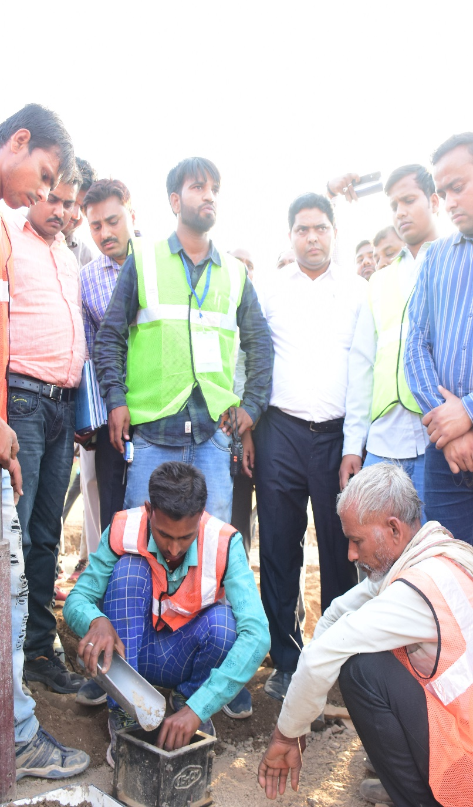
FDR Mix Design – Tests Used
Particle size analysis – IS 2720 (Part 4) for particles less than 4.75 mm, IS 2386 (Part 1) for more than 4.75 mm size
Liquid limit (LL) and Plastic limit (PL) – IS 2720 (Part 5)
Modified Proctor Compaction test – IS 2720 (Part 8)
Compressive strength test (IS 516)
15 cm cube moulds, Needle Plate Compactor usage
UCS & Proctor tests – Replace particles more than 38 mm size by equal weight of particles between 4.75 to 37.5 mm
Durability Test as per IRC SP:89 using 15 cm cube samples – Method 1 (Moderate Climate) or Method 2 (Large variations in temperature and climatic condition)
Cement and Water (IS 456) Tests – Potable water

Slide 11
FDR Mix Design
Create a mix design report with the established cement content/CCS content and moisture/density information. It shall include:
Gradation of combined mixture (including RAP)
LL, PL, and PI of combined material (if applicable). MDD and OMC of the FDR mixture
Unconfined compressive strength at each trial cement content
Wet density of UCS test specimens before and immediately after moist curing period
Recommended cement content as a percentage of dry materials (Material certifications and source information for Portland cement)
Graph of UCS versus the percent of cement in the mixture. The moisture/density curve should also be provided for the recommended cement content. Graph that shows the average moisture-conditioned UCS and wet-dry durability for each mixture versus the percentage of cement in the mixture. The recommended spread rate specified in kg/sqm for the cement should be provided so that a correct amount of cement is applied during construction.

Slide 12
Mix Design Results in Pilot FDR Projects
Project Name/ District | Average MDD (Kg/Cum) | OMC (%) | Cement (%) | Additive (%) by weight | Mix Design Prepared by/used additive | Average UCS (MPa)
Archha Barethi Kamsin Road (Chitrakoot) | 2120 | 9.20 | 5 | Terrasil: 0.85kg/cum of RPM & Zycobond: 0.85kg/cum of RPM | IIT Roorke (Additive-Terrasil & Zycobond) | 4.77 (7 days) 5.26(28 days)
T-03 G.T. Road Hanumanganj to AG Road phoolpur (Prayagraj) | 2120 | 9.20 | 5 | 100 ml/cum | IIT Roorke (Additive-Roadstab) | 5.18 (7 days) 6.93 (28 days)
MRl04 Jam road km 424 to Laktaha ghat (Prayagraj) | 2060 | 10 | 4 | 650 ml/cum | IIT Roorke (Additive-Baseseal) | 4.51 (7 days) 5.26 (28 days)
T02 T01 (km 413) to Charkhari (Hamirpur) | 2000 | 8.66 | 5 | 2% of cement | Terrastab/TIMAB NLBB, Netherlands (Additive-Geocrete) | 5.15 (7 days) 8.77 (28 days)
L060 Nouranga- Bakrai – Khota to Tooka (Hamirpur) | 2000 | 9.73 | 5 | 1.5% of cement | Terrastab/TIMAB NLBB, Netherlands (Additive-Geocrete) | 5.66 (7 days) 8.65 (28 days)
MRL06 – T01 to Gobara (Jhansi) | 2000 | 5.30 | 5 | 1.5% of cement | Terrastab/TIMAB NLBB, Netherlands (Additive-Geocrete) | 5.41 (7 days) 8.62 (28 days)
T04- Etmadpur to Barhan (Agra) | 2352 | 6.50 | 4 | 3.5% of cement | IIT Roorke (Additive-Geopave) | 5.26 (28 days)
T01- BaldevMai to Khandoli (Hathras) | 1987 | 7.58 | 4 | 4% of cement | IIT Roorke (Additive-Geopave) | 4.89 (7 days) 6.03 (28 days)
MRL12-Tarapur to Bhogoan (Mainpuri) | 2086 | 7.85 | 5 | 4% of cement | IIT Roorke (Additive-Geopave) | 4.56 (7 days) 6.75 (28 days)

Slide 13
Construction Procedure
Cement/CCS
In-situ stabilization involves the following operations:
Plant-mix stabilization
Mix-in-Place stabilization
Preparation of ground
Spreading of Stabilizer (Cement+CCS)
Mixing
Compaction and Finishing

Slide 14
Field Testing for quality checks during construction
Strength of Sub-grade
Pulverization and Gradation
Cement + CCS Content
Uniformity in Mixing
Water Content – Moisture Content
Density of FDR layer
Strength and thickness of FDR layer
Stiffness of FDR layer
Quality Control in case of FDR with cementitious/CCS material

Slide 15
Evaluation of Strength
Stiffness Evaluation
Falling Weight Deflectometer (FWD)
Light Weight Deflectometer (LWD)
Soil Stiffness Gauge (SSG)
Field Testing for Strength
Dynamic Cone Penetrometer (DCP)
Mould Casting
Core cutting

Slide 16
  Check for Cement Content
Spot check—
In this, a sheet of canvas, usually 1 m2 in area, is placed ahead of the cement spreader. After the spreader has passed the canvas, the cement is carefully picked up and weighed (Adjacent Figure).
Overall check—
The distance or area is measured over which a truckload of cement of known weight is spread. This actual area is then compared with the theoretical area, which the known quantity of cement should have covered.

Slide 17
  Check for Mixing Uniformity
A commonly used chemical to determine the presence of calcium in cement-stabilized materials is phenolphthalein. A chemical reaction between the phenolphthalein and cement in the FDR mixture produces a pinkish-red colour, indicating the presence of cement (Adjacent Figure).
If the pinkish-red colour extends to the bottom of the specified FDR depth, adequate mixing has been achieved. However, if the pinkish-red colour does not extend to the full depth of the FDR layer, mixing operations should be modified to ensure cement is evenly mixed throughout the FDR depth.

Slide 18
  Check for Density
After final rolling is completed, in-place density tests should be performed at several locations on the first few sections completed. A density (Adjacent Figure) gauge can be used to determine the degree of compaction obtained in the field to avoid disturbance in the stabilized layer. It should be noted that density gauges should be properly calibrated, operated, and maintained to ensure that results are accurate.
In the absence of density gauge, Sand replacement method or determination of density of extracted core by wax coating method may be used. The density of the layer should not be less than 100% of the maximum density of the cement treated mix as determined in the laboratory.

Slide 19
  Check for Strength
A core specimen for the determination of compressive strength shall have a diameter at least three times the maximum nominal size of the coarse aggregate used in the stabilized layer, and in no case shall the diameter of the core specimen be less than twice the maximum nominal size of the coarse aggregate.
The length of the specimen, when capped, shall be as nearly as practicable twice its diameter. Therefore, it is recommended that not less than 150 mm diameter core should be obtained from the FDR layer for verification purposes (Adjacent Figure). Cores should be taken on the seventh day after completion of the FDR layer for in-place compressive strength testing.

Slide 20
  Check for Strength
Alternatively, in-situ resilient modulus of the FDR layer can be evaluated through measurement of deflection using a Falling Weight Deflectometer (FWD) and then back calculating the resilient modulus. The in-siture silient modulus will be compared with the resilient modulus as determined using equation.
Adjacent Figure shows structural evaluation of a stabilized pavement using FWD.

Slide 21
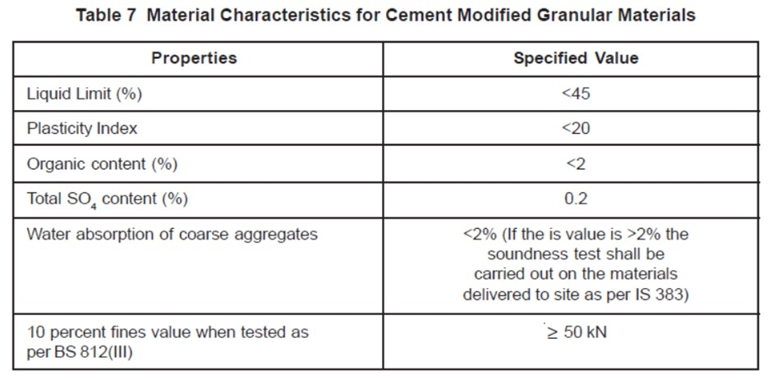
Gradation and Atterbergs Limit as per MORTH

Slide 22
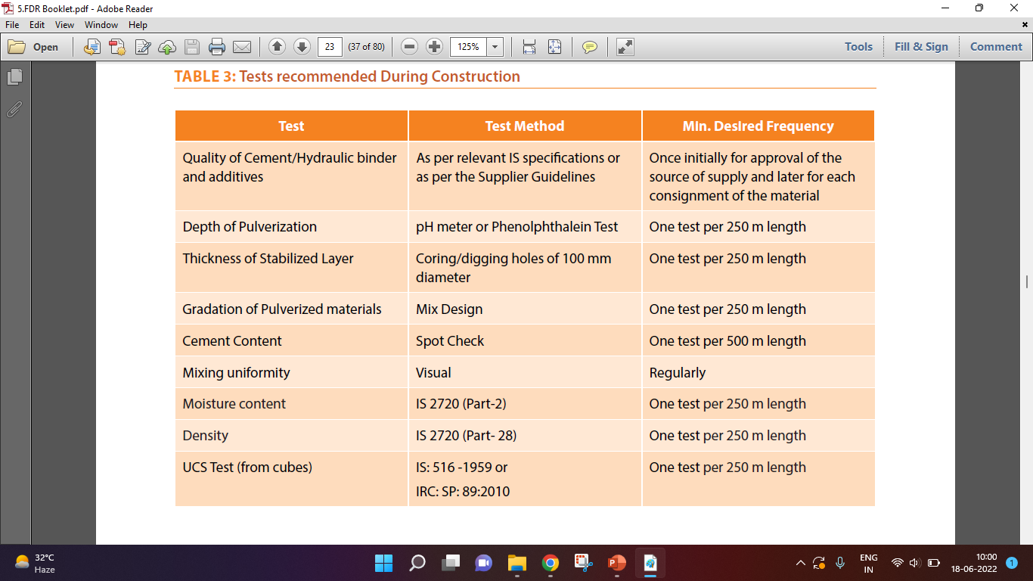
  Test recommended during construction

Slide 23
  Test recommended during after construction
  ACCEPTANCE CRITERIA

Slide 24
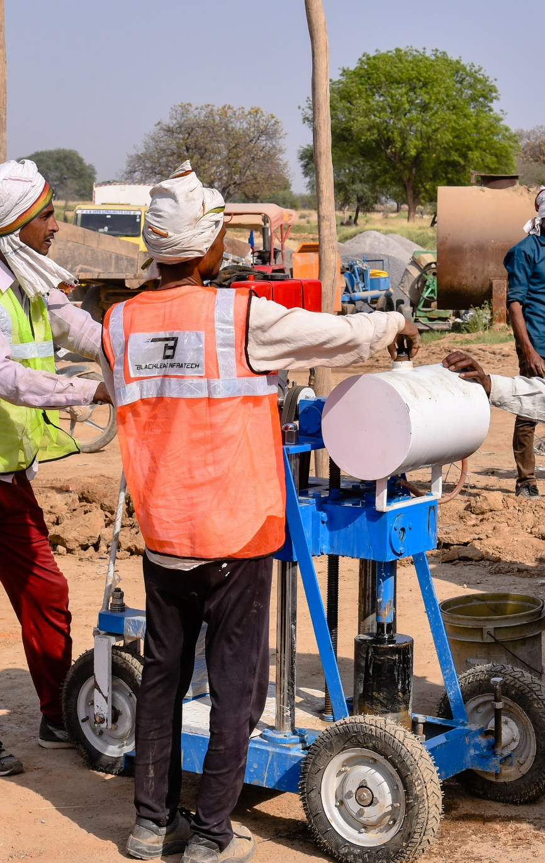
  Standard to follow
ASTM-D1632 – 17: Standard Practice for Making and Curing Soil-Cement Compression and Flexure Test Specimens in the Laboratory
ASTM-D559 – Test methods for Wetting and Drying Compacted Soil-Cement Mixtures
IRC:SP-89:2010- Guidelines for Soil and Granular Material Stabilization using Cement, Lime and Fly Ash
IRC:SP-89-Part : II-2018- Guidelines for the Design of Stabilized Pavements

Slide 25
  Format for GRADATION TEST

Slide 26
  Format for CEMENT SPREADING RATE

Slide 27
  Format for DEPTH MIXING

Slide 28
  Format for CUBE STRENGTH

Slide 29
  Field Density using Sand Replacement Method

Slide 30
  Field Density using Density Gauge

Slide 31
  Thickness of Layer & Strength of Core

Slide 32
  Layer Stiffness Evaluation using DCP

Slide 33
  Layer Stiffness Evaluation using FWD

Slide 34
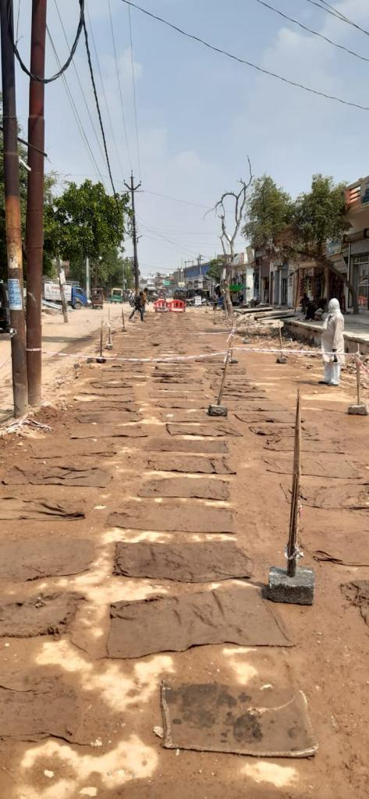
  Retaining Moisture after Curing
  Curing FDR layer, maintaining the right moisture content is important and it is done at some of the projects.

Slide 35
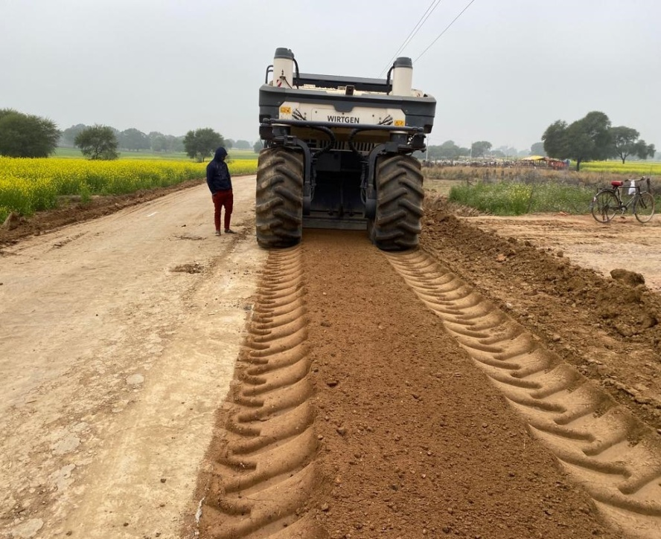
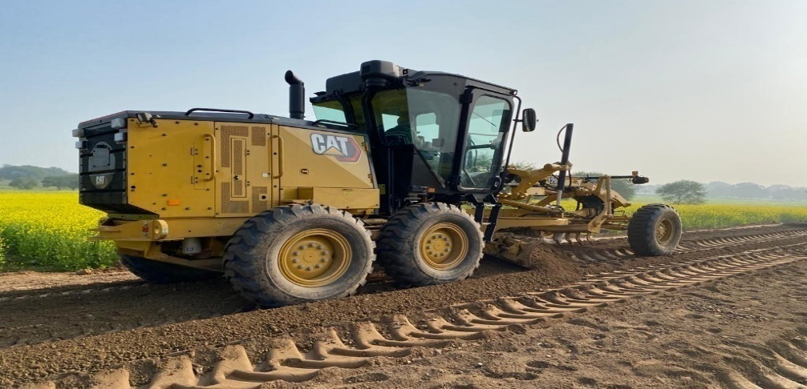
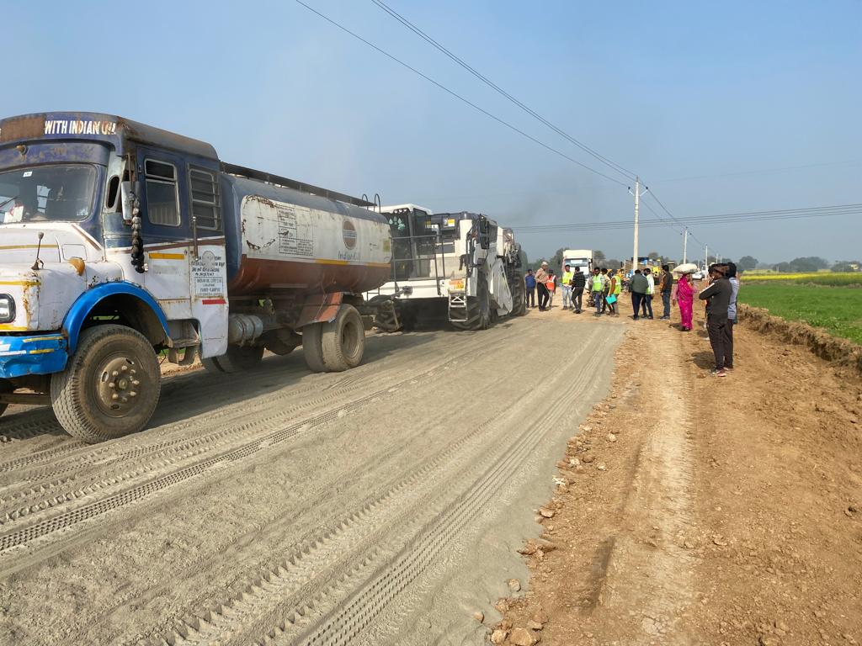
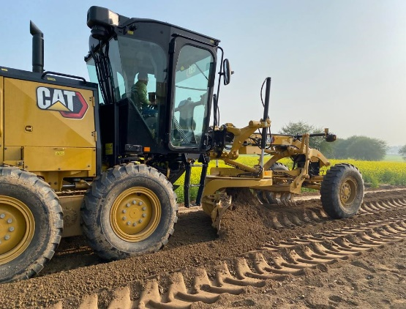
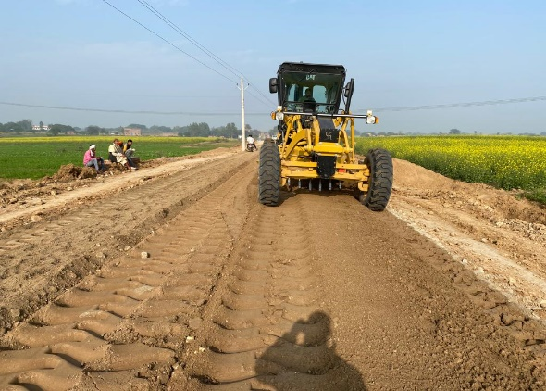
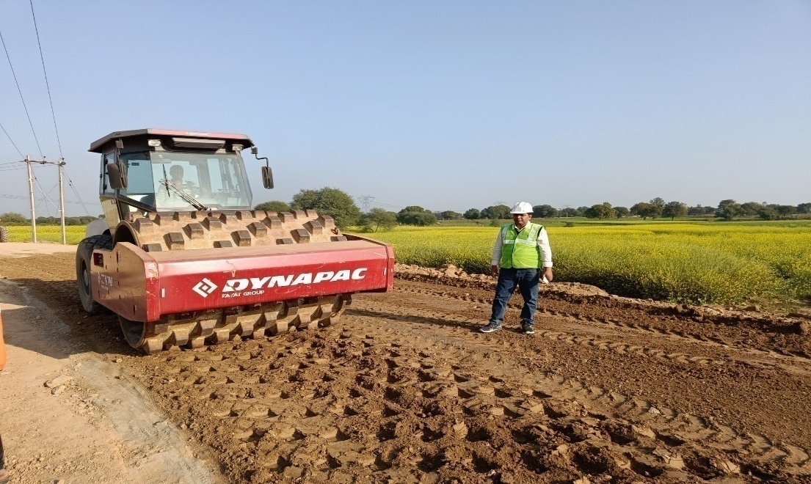
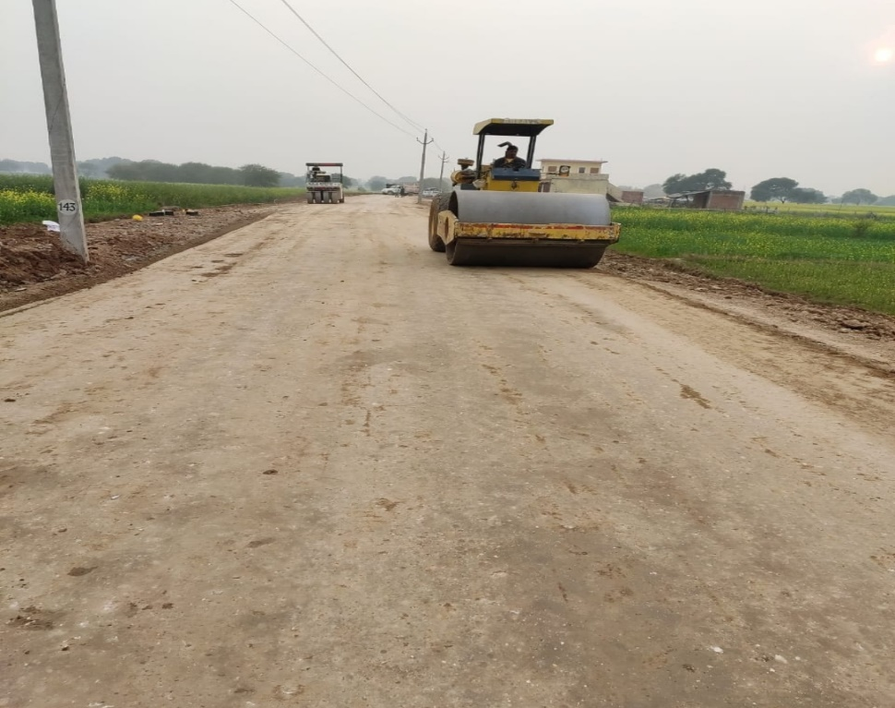
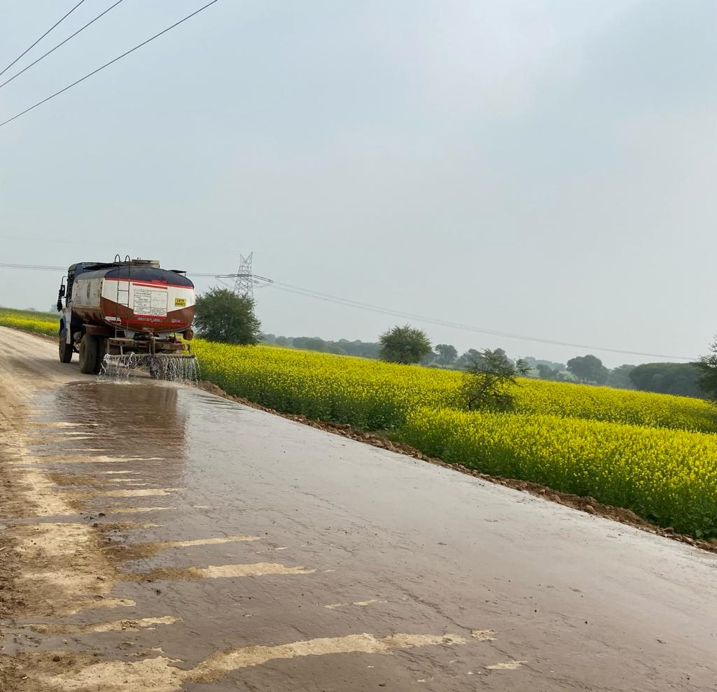
  FDR-01 @ Chitrakoot (UP1985) T05 Archha Barehi Kamasin Road

Slide 36
Inspection Points to be checked by SQM
Establishment of Information sign board and citizen board.
Collection of material for JMF(Representative Sample).
Procurement and Evaluation of JMF.
Establishment of Bench Mark(RBM/TBM) reference piller, check road geometry.
Establishment of central laboratory and packagewise laboratory
- Equipment available, Their caliberations, Their Technical Staff.
Execution of Embankment/subgrade.
Density -NMC - OMC -MDD
Availability of train of equipments, machines-owned/hired.
Additive use
- Consumption calculations
- IRC Accreditation for Additive
QCR Items
Spreading of Cement/Additives
-Test Related with shoulders/Subgrades.
-Geometrics

Slide 37
Inspection Points to be checked by SQM
Test conducted during stabilizations-trial patch/ construction
- Grading
- OMC/NMC/MDD
- Density(sand replacement method)(if construction is under going during the
inspections. this tests can be done by the SQM)
- Homogenous mixing(Phenopthelene test)
- Strength by cube tests.
- Records of cube/Core tests.
Prime coat
Tack coat
Sami Layer
Make of and type of Sami material.
Tack coat benith BC.
BC related tests.
Culverts/drains
Road Furniture.

Slide 38
List of LAB EQUIPMENTS
Sr.No | NAME | Nos
1 | Moisture meter (RMM) | 1
2 | Core cutter sand Replacement with Sand | 1Set
3 | Compression Testing Machine | 1
4 | Temperature Controlled oven | 1
5 | California Bearing Ratio (CBR) | 1Set
6 | Weighing Balance 10 kg | 1
7 | Cubes Mould (150*150*150) | 30
8 | Tamping Road (16*600*16*3001 | 1
9 | Impact value of aggregate | 1
10 | Vibration Table | 1
11 | Flakiness Gauge | 1
12 | Elongation Gauge | 1
13 | weight machine (50 KG) | 1
14 | Weighing Machine 600g | 1
15 | Pycnometer bottle (1000 MI) | 2
16 | Proctor mould 2250Cc | 1
17 | Proctor mould 1000Cc | 1
18 | Hammer falling Length (450mm) | 1

Slide 39
List of LAB EQUIPMENTS
Sr.No | NAME | Nos
19 | Measuring Cylinder (100 ml) | 4
20 | Measuring Cylinder (1000 ml) | 4
21 | Atterberg's limits (Casagrande & Penetrometer) | 1
22 | Container box | 50
23 | Trowel | 4
24 | Spatula | 5
25 | Scoop | 3
26 | Dropper (500 ML) | 3
27 | Measuring Tapes 5 meter, 30m, 50m
28 | Metal Tray (300*470)(635*490)mm | 3+2
29 | Sieves BRASS: - 600mic,425mic,300mic,150mic,75mic,4.75mm,1.18mm,2mm,90mic GI SIEVES;- 1mm,1.6mm,6.7mm,10mm,13.2mm,2.36mm,11.2mm,16mm,25mm,63mm, 40mm, 50mm,20mm,31.5mm, 22.4mm,75mic,26.5mm,9.5mm,37.5mm,19mm,45mm,53mm PAN

Slide 40
List of LAB EQUIPMENTS
Sr.No | NAME | Nos
30 | Core Cutting Apparatus (FDR & BC Layer) | 1 Set each
31 | Core cutting, FDD Soil | 1 Set
32 | BC Density Apparatus | 1
33 | Bitumen Extraction Apparatus | 2
34 | Digital Thermomates | 3
35 | BC Depth guage | 5
36 | Comber plate with sprit level 3 m | 1 Set
37 | Auto level | 1 Set
38 | Slump Core Apparatus | 1 Set
39 | Soaking Tank | 1 Set

Slide 41
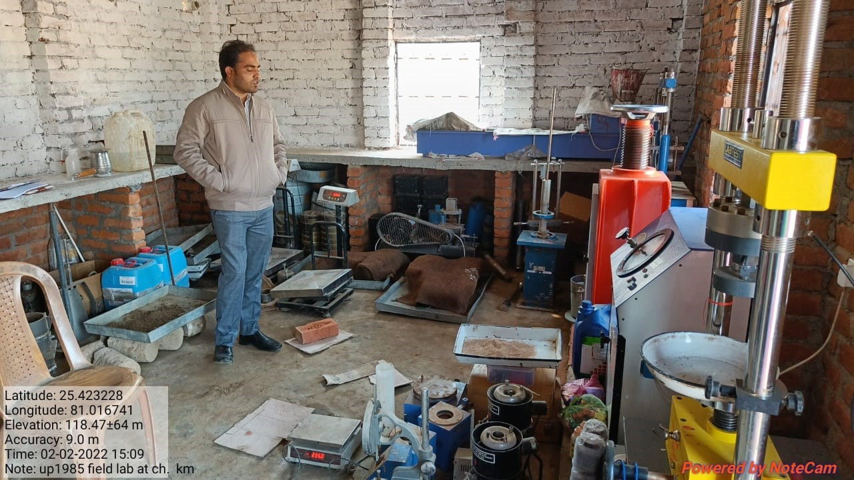
Package NO. UP 1985

Slide 42
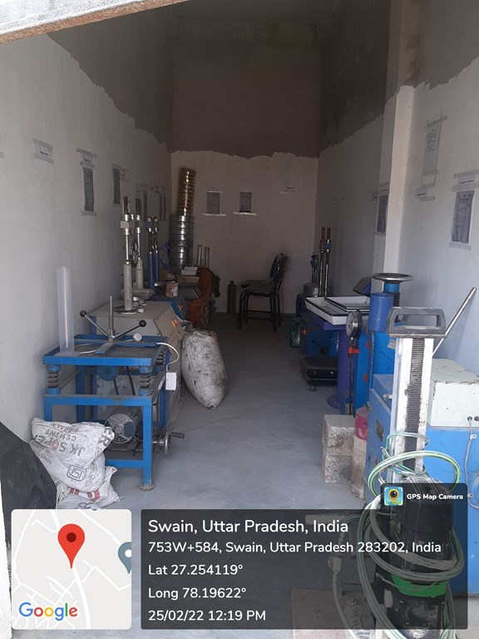
Package NO. UP 0192

Slide 43
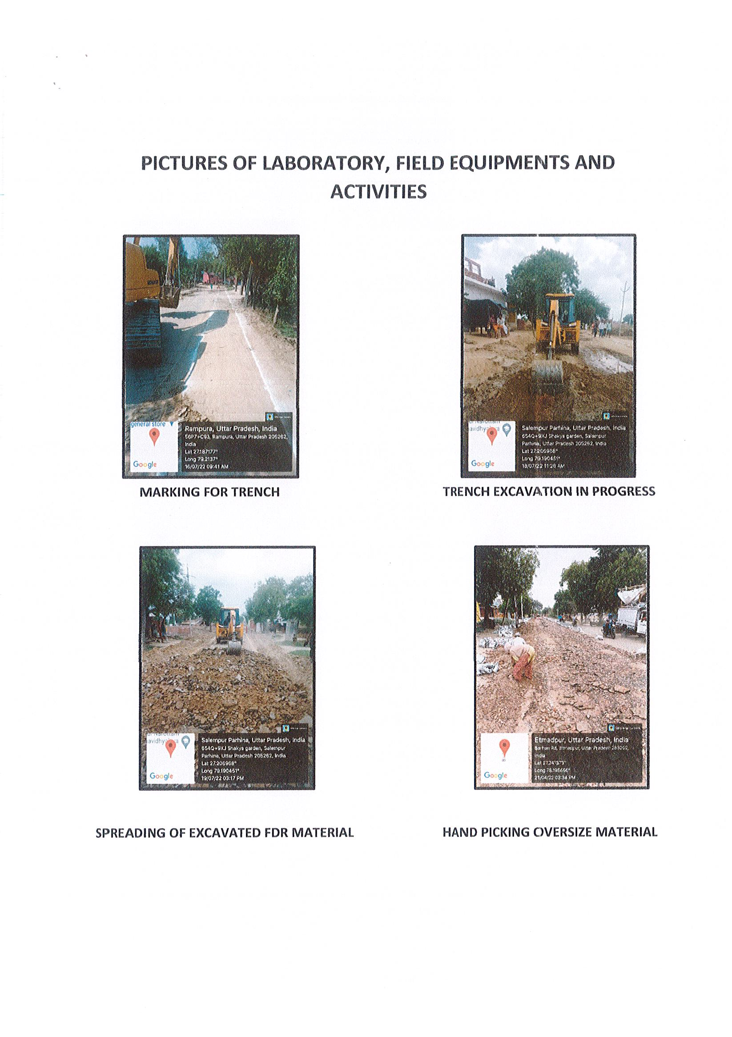

Slide 44
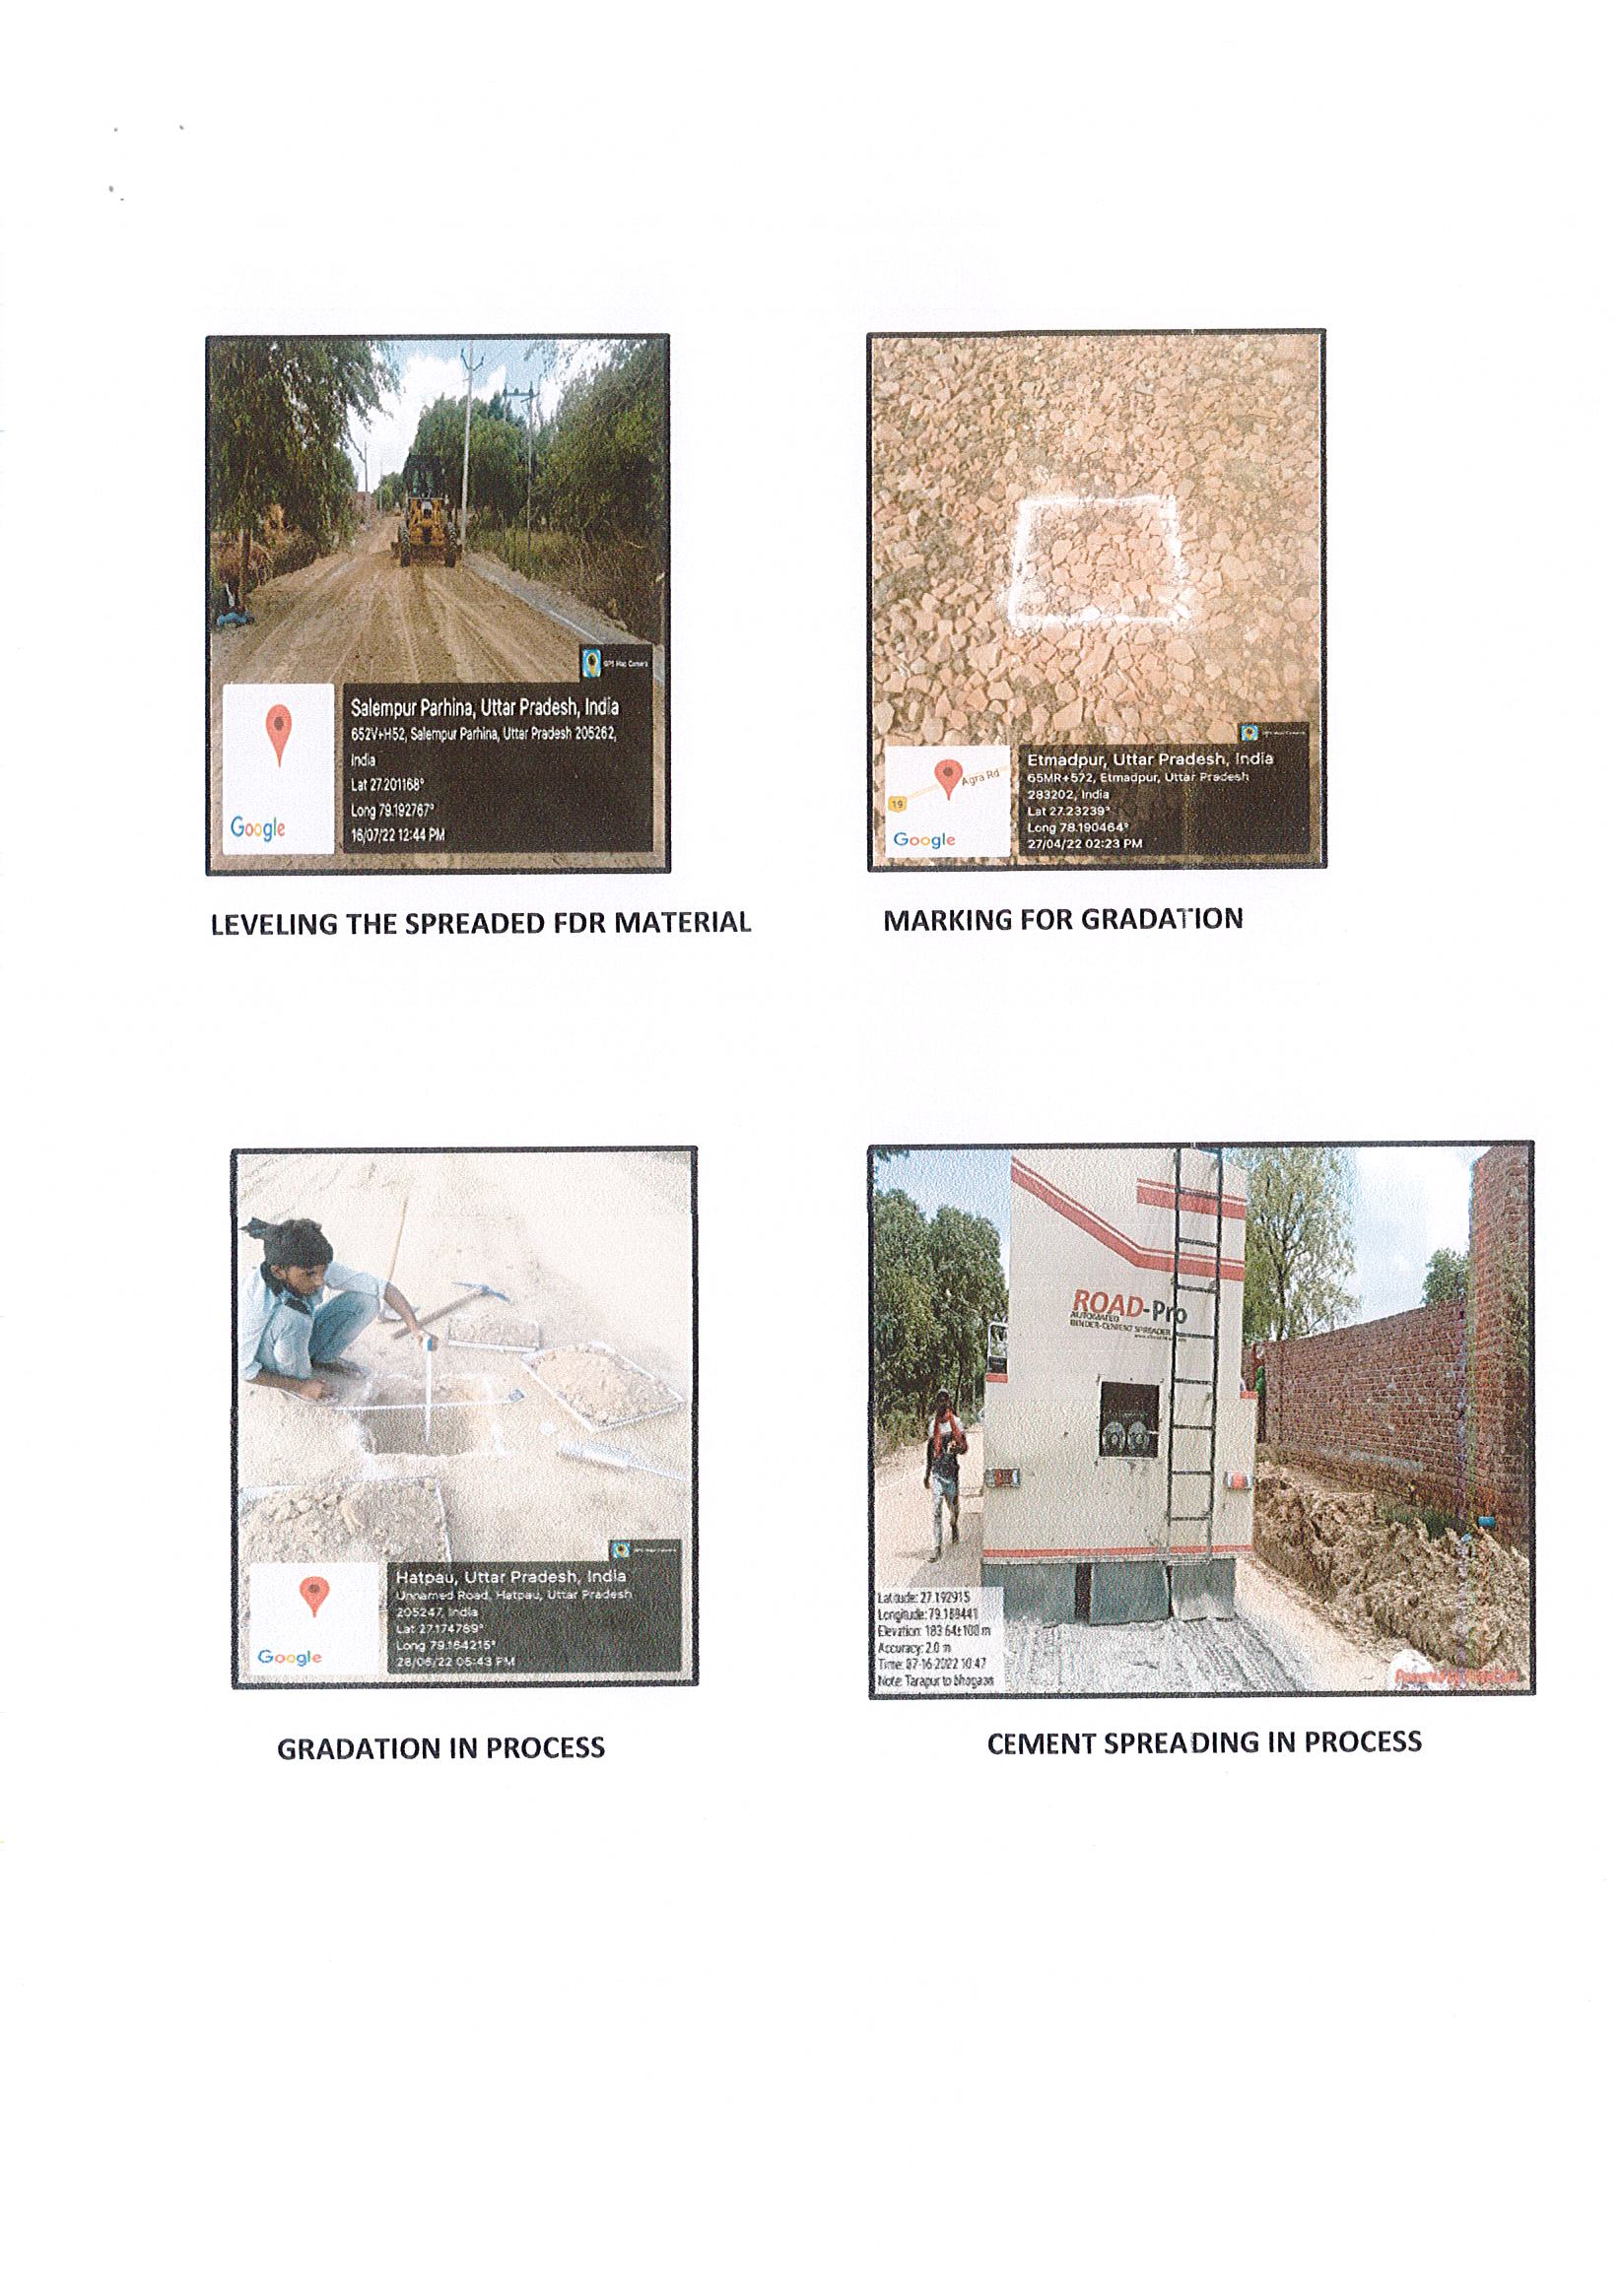

Slide 45
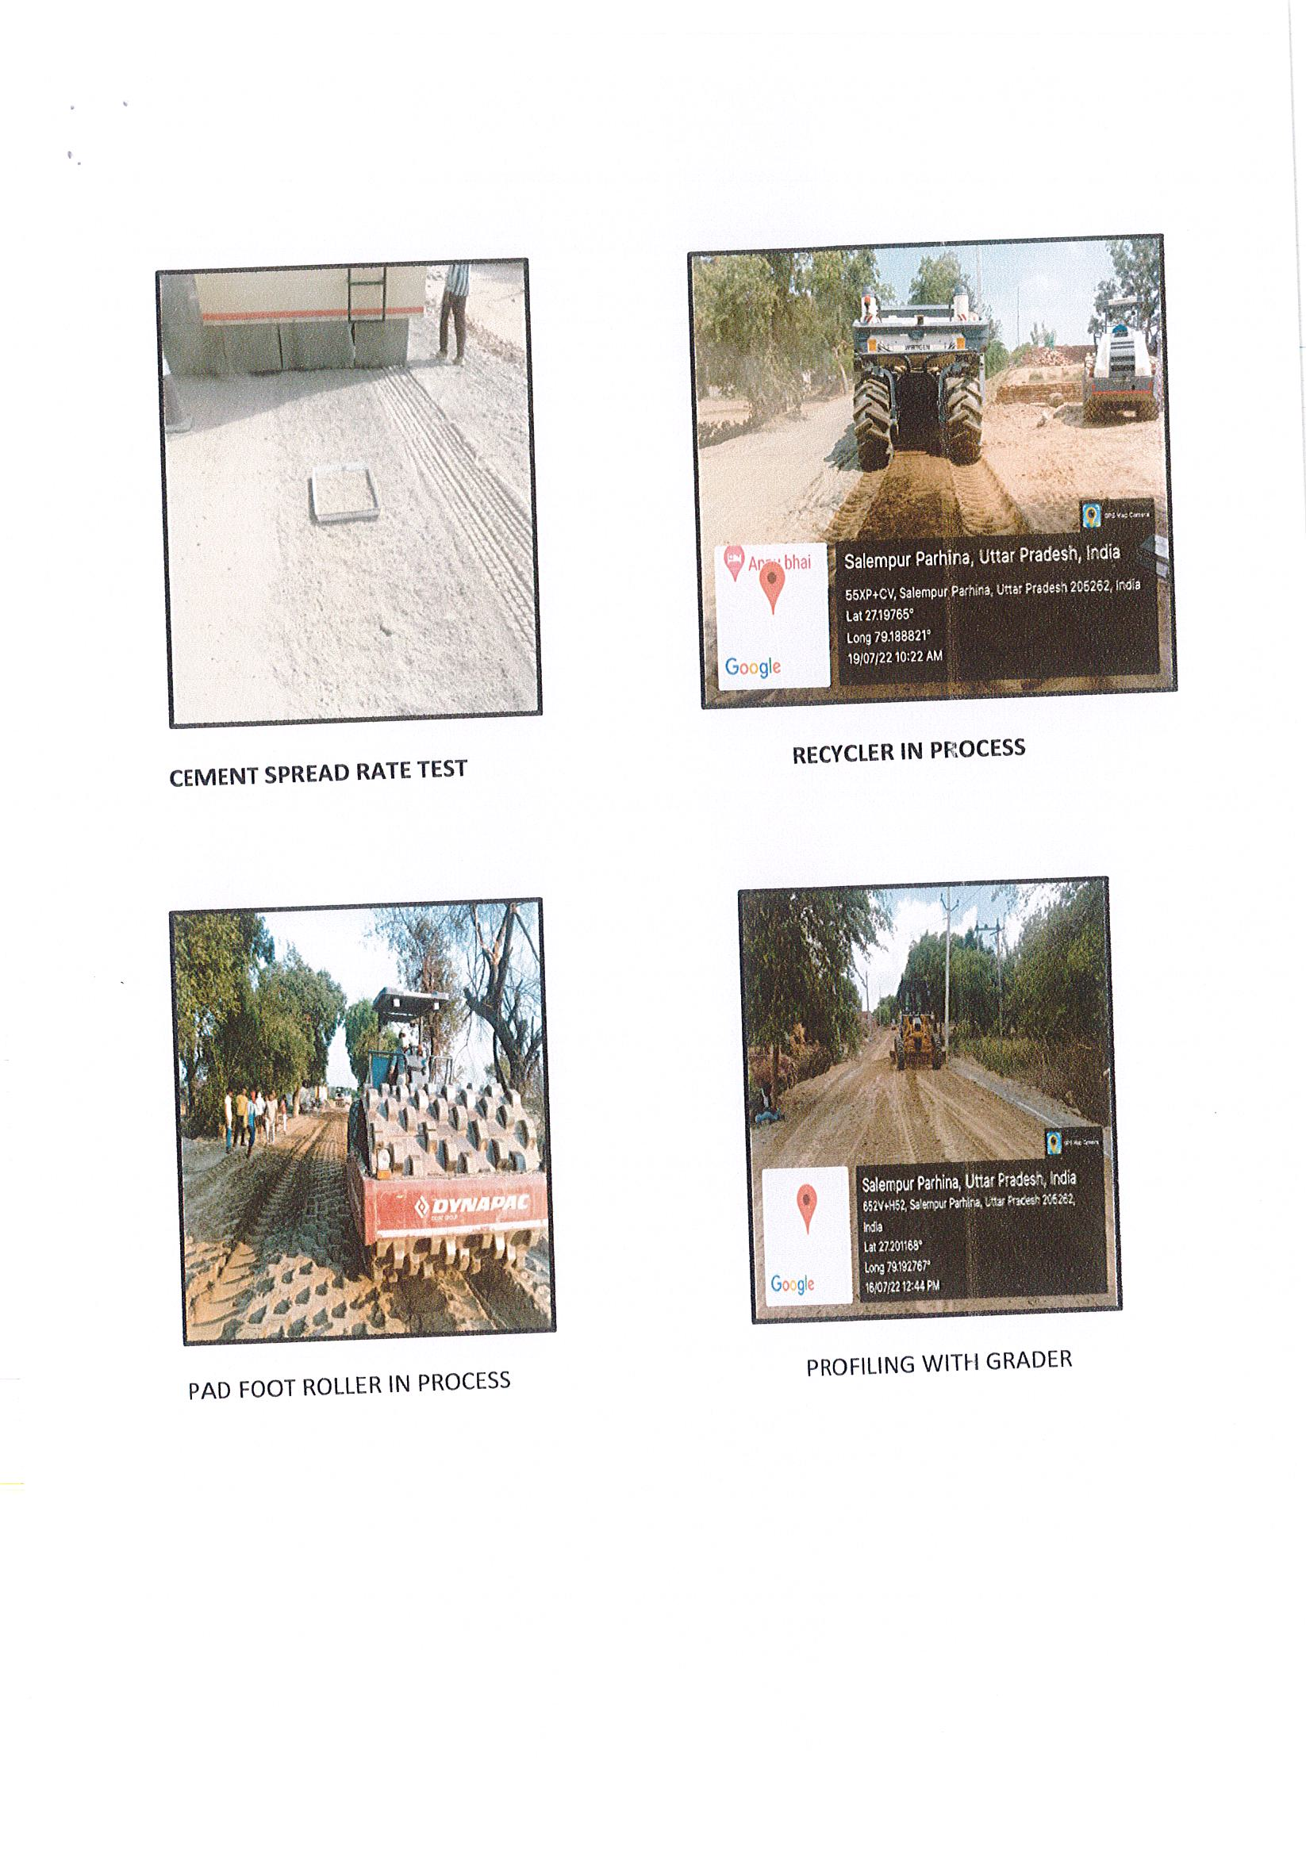

Slide 46
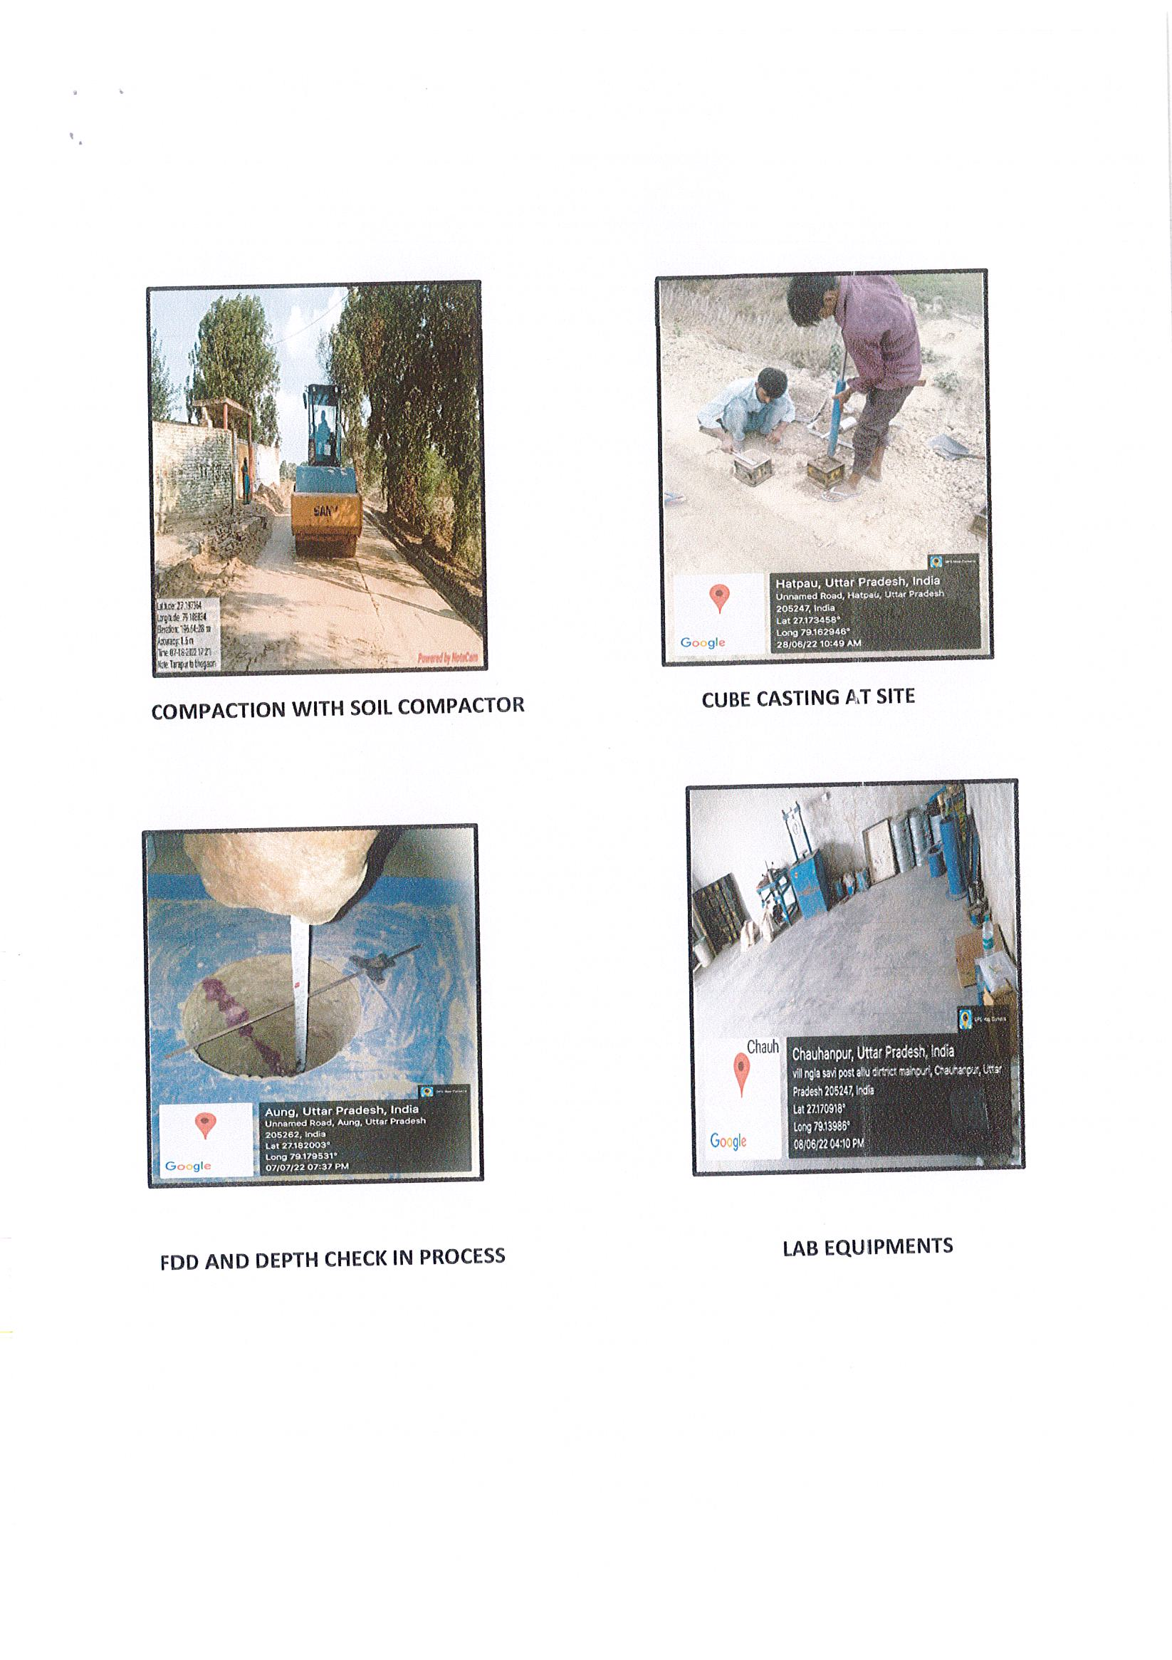

Slide 47
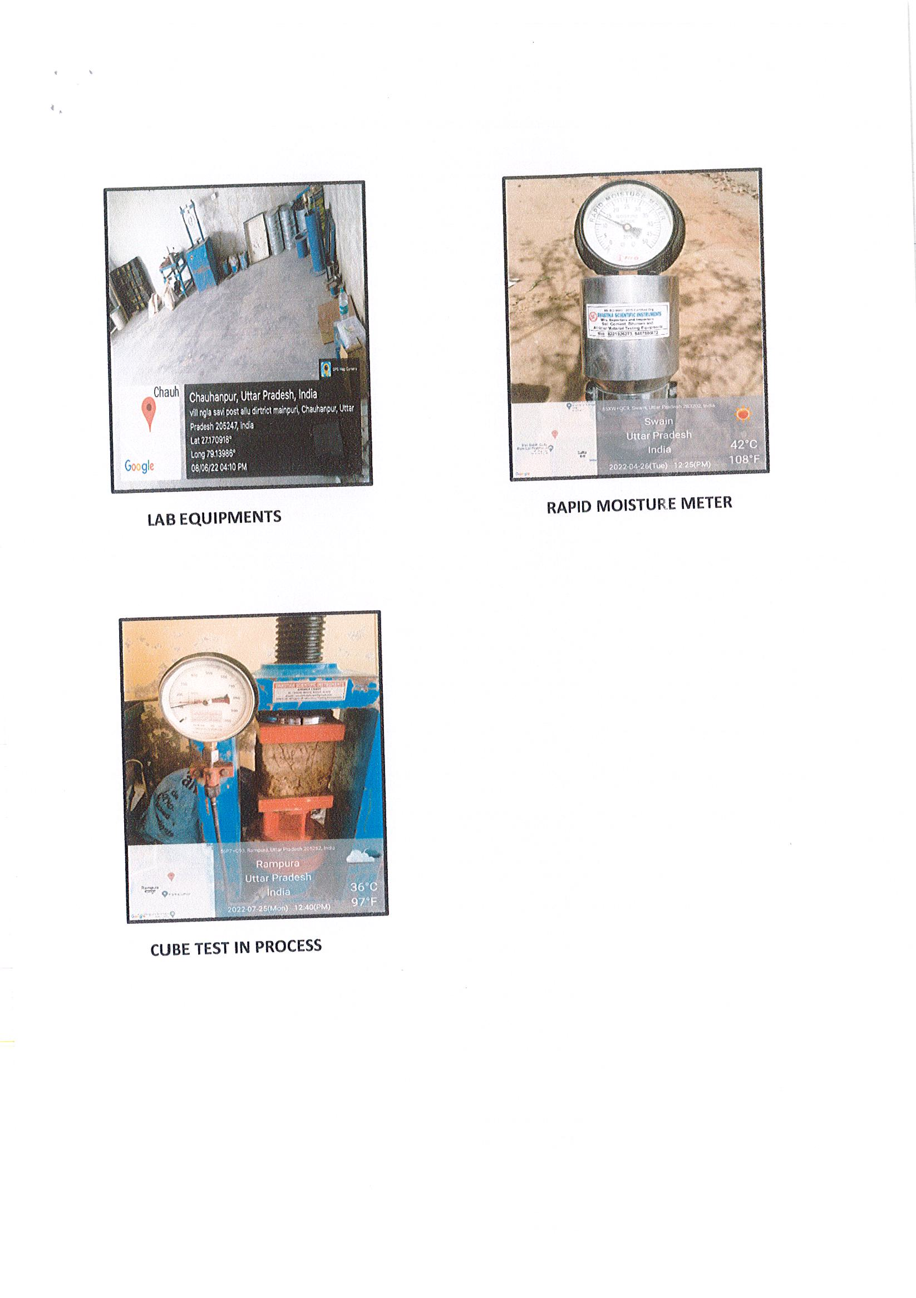

Slide 48
SAMI Layer – Paving Fabrics
The paving fabric - non-woven heat set material consisting of at least 85 percent by weight of polyolefins, polyesters or polyamides.
- Shall be resistant to chemical attack, rot and mildew
- Shall have no tears or defects which will adversely alter its physical properties.

Slide 49
SAMI Layer – Physical Requirement
Property | Units | Standard Requirements | Test Method
Grab Tensile Strength | N | 450 | ASTM D 4632
Elongation | % | ≥50 | ASTM D 4632
Mass Per Unit Area | gm/m² | 140 | ASTM D 3776
Asphalt Retention | Kg/10 sq. m | 10* | ASTM D 6140
Melting Point | ºC | 150 | ASTM D 276
Surface Texture | ⁻ | Heat bonded on One side only | Visual Inspection

Slide 50
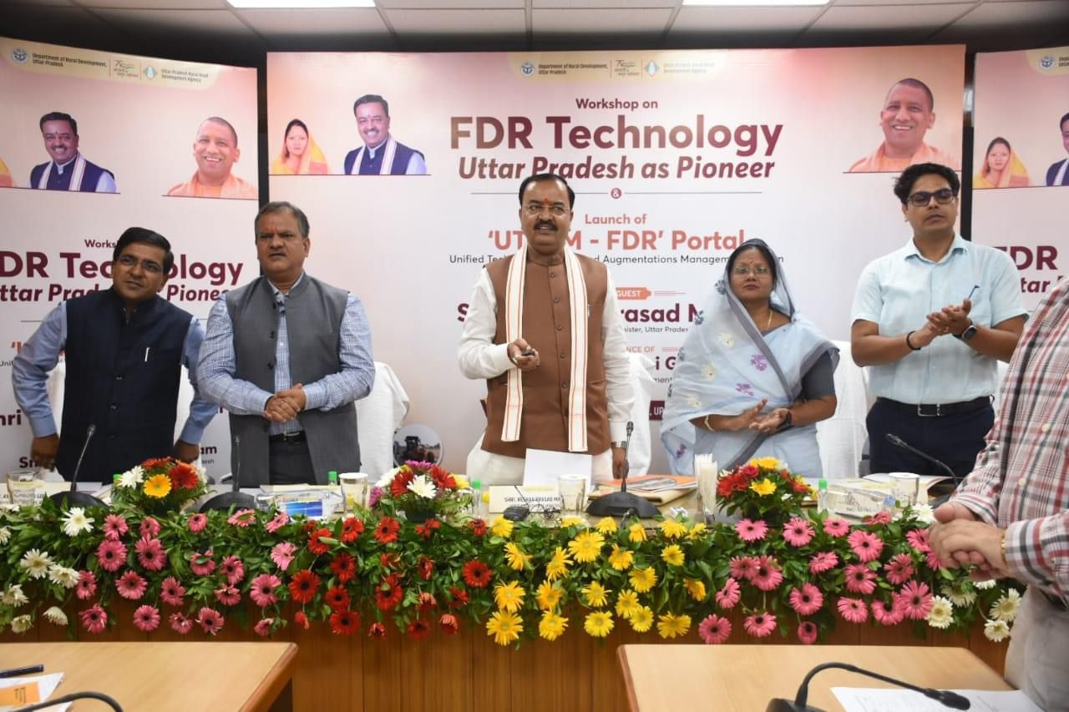

Unified Technical Tracking And Augmentation Management System (UTTAM)
UTTAM (Unified Technical Tracking & Augmentation Management) portal for physical, financial & quality test monitoring of FDR works launched on 16.08.2022 by Hon’ble Dy Chief Minister of Uttar Pradesh Sri. Keshav Prasad Maurya Ji. In presence of Hon’ble MoS Rural Development Smt. Vijay Laxmi Gautam Ji, Sri Manoj Kumar Singh (IAS), APC(GoUP) & Dr. Ashish Goel (IAS), Additional Secretary (MoRD, GoI & DG-NRIDA.

Slide 51
UTTAM Portal Work Flow
Management of Basic Details of FDR Road Projects under UPRRDA
Management of Contractors Basic Details
Management and Tracking of Quality Tests on Road Projects
Tracking of Billing and Financial Progress of the Projects
Verification of Quality Tests Data by PIU
Verification of Quality Tests Data by PMU
Site Visits and Random Tests Management on FDR Road Projects
Geotagged Photographs Management
Dynamic Reporting on Data upload at various stages
Provide accurate and timely information at various levels to assist the concerned stakeholders in effective decision making
Provide a user-friendly system with a Graphical User Interface

Slide 52
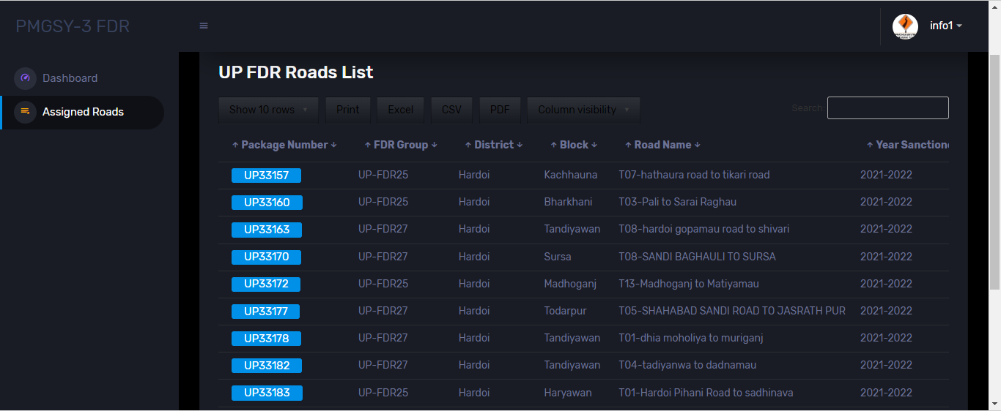
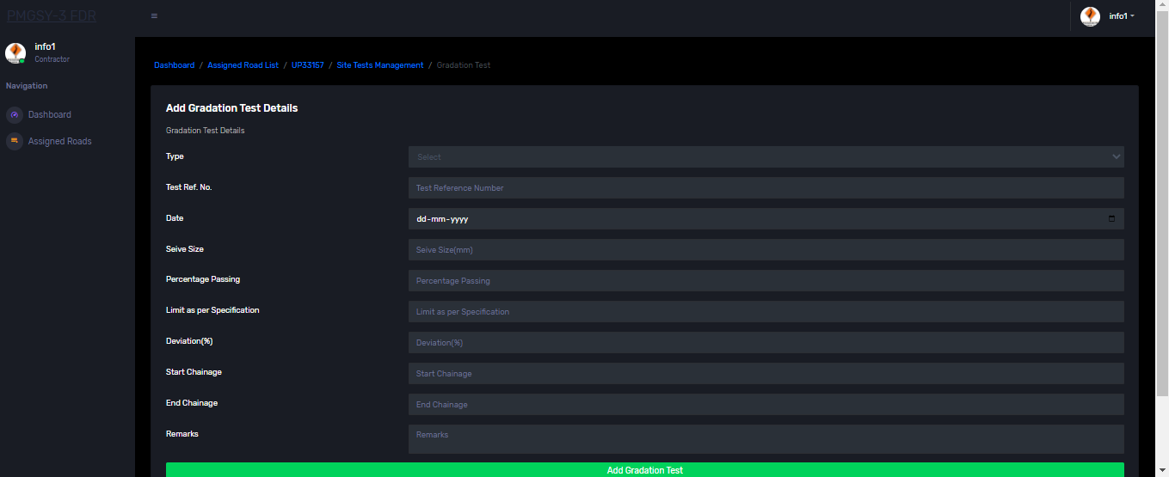
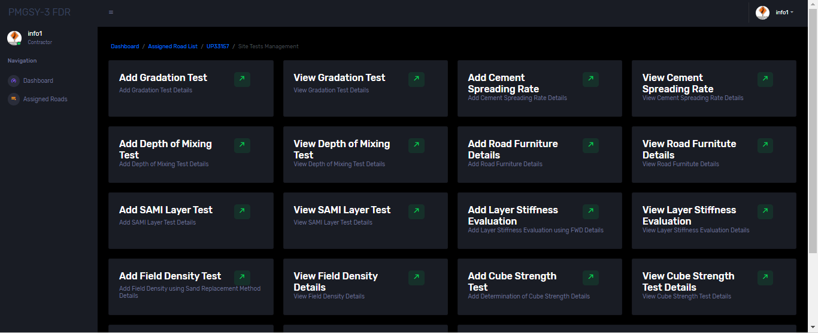
UTTAM Portal

Slide 53
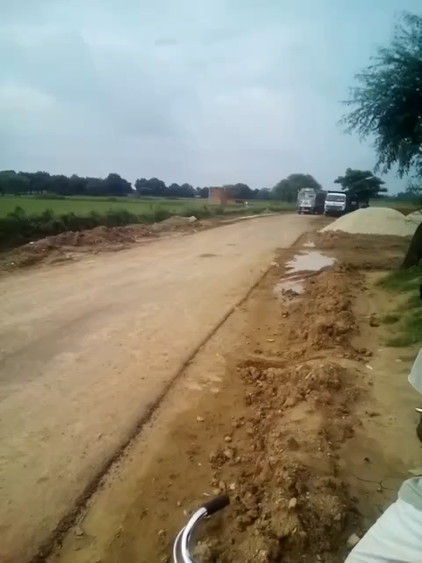

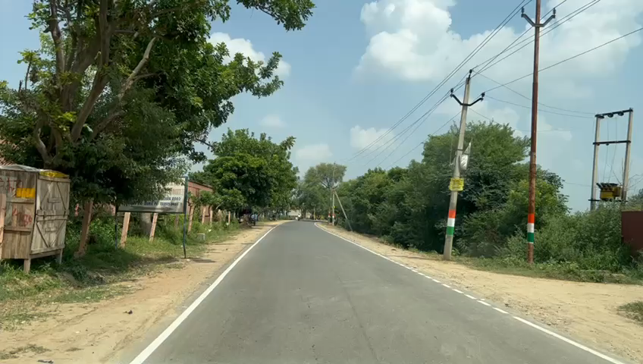
Actual Performance of FDR
Agra FDR Road
Traffic Diverted to FDR Road at Chitrakoot from State Highway

Slide 54
Contract Management
Work Program
Insurance of man , machine , material and others
Mile stone and its achievement
Imposing Liquidity damage
Billing by contractor
Completion and financial closure

Slide 55
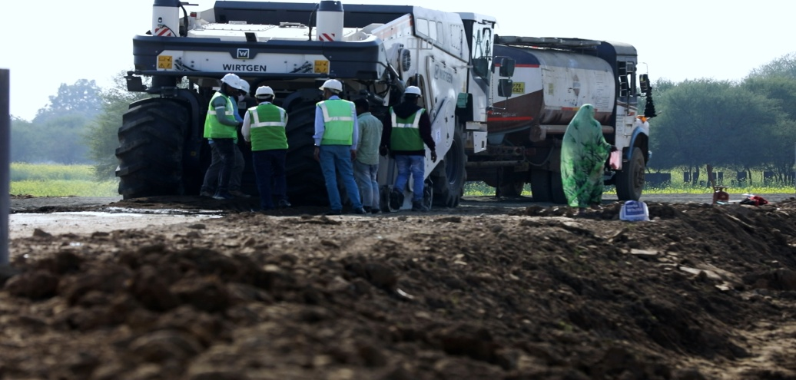

THANKS
@ UPRuralDev

